Slide 1

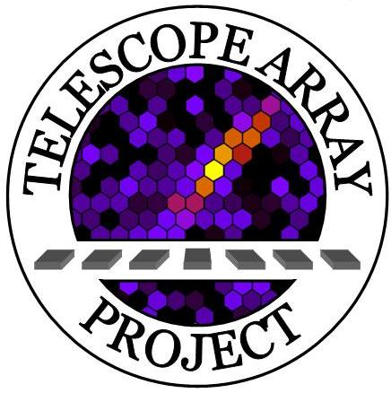
The Composition of Ultra High Energy Cosmic Rays Through Hybrid Analysis at Telescope Array
Elliott Barcikowski
PhD Defense
University of Utah, Department of Physics and Astronomy
Thursday, September 29th, 2011

Slide 2
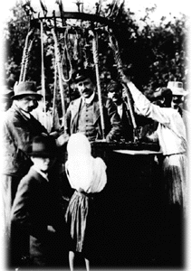
What are cosmic rays?
Relativistic atomic nuclei originating outside the Solar System
“Ultra High Energy” → E > 10¹⁷eV
First discovered by Victor Hess by measuring radiation in high altitude balloon flights (1911-1913)
Awarded the Nobel Prize in physics in 1936
Produced by the most energetic processes in the Universe
Galactic: Super novae
Extragalactic: Active Galactic Nuclei
Notes:
AGN -- Very bright in center of core. Due to accreation by supermassive black hole
Often have jets – relativistic plasma that is collimated out of core
Radio Galxies – loud in radio, sycrotron radtination – CenA
Blasar – jet pointing to Earth
Quasaer – High red shift
Blac -- Blasar with spectral feartures?

Slide 3
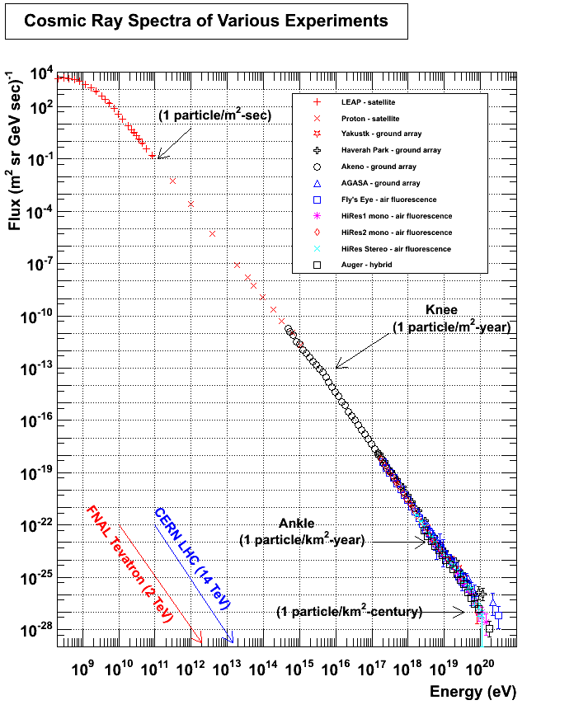
The All-Particle Spectrum
Steady power law over many decades in energy
Large flux at low energies
Low flux for Ultra High Energies
Much higher in energy than may be produced in an accelerator

Slide 4
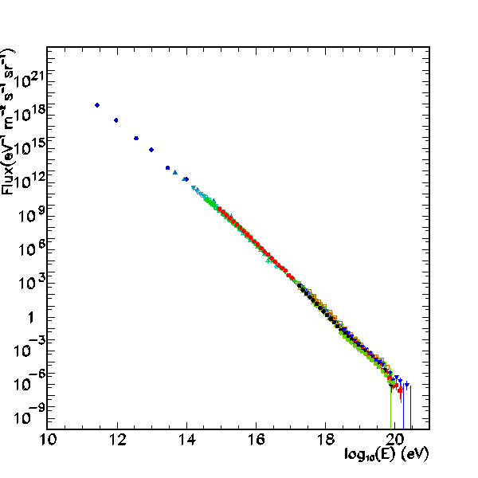
The All-Particle Spectrum
Four clearly defined spectral features
Knee
2nd Knee
Ankle
Cutoff

Slide 5
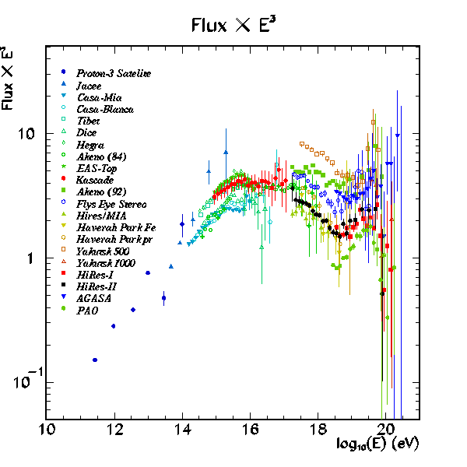
The All-Particle Spectrum
Four clearly defined spectral features
Knee
2nd Knee
Ankle
Cutoff
Knee
2nd Knee
Ankle
Cutoff

Slide 6
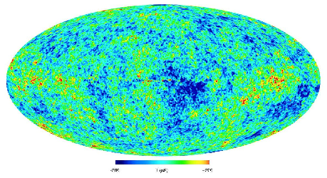
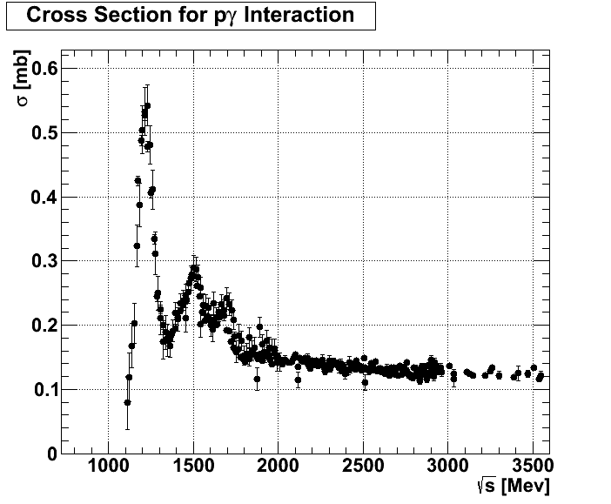
Cutoff
Predicted in 1966 by Greisen, Kuzmin, and Zatsepin
Coined the “GZK” Cutoff
First observed by HiRes
Requires protons
Alternative: acceleration limit?

Slide 7
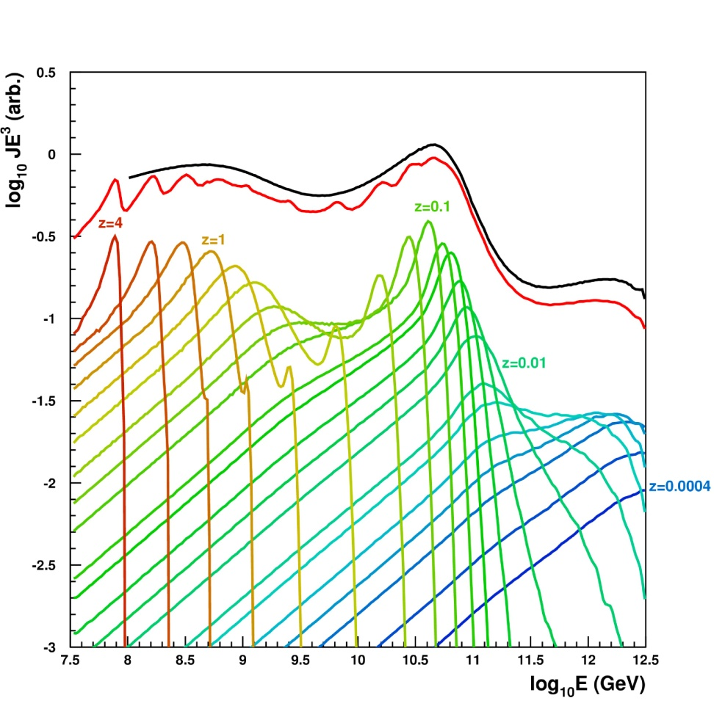
Ankle
Produced by pair production combined with GZK “pile up”
First shown by Berezinsky, 1988
Requires protons
Alternative: extra-Galactic transition?
Reproduction of Berezinsky’s modeled comic ray spectrum by D. Bergman

Slide 8
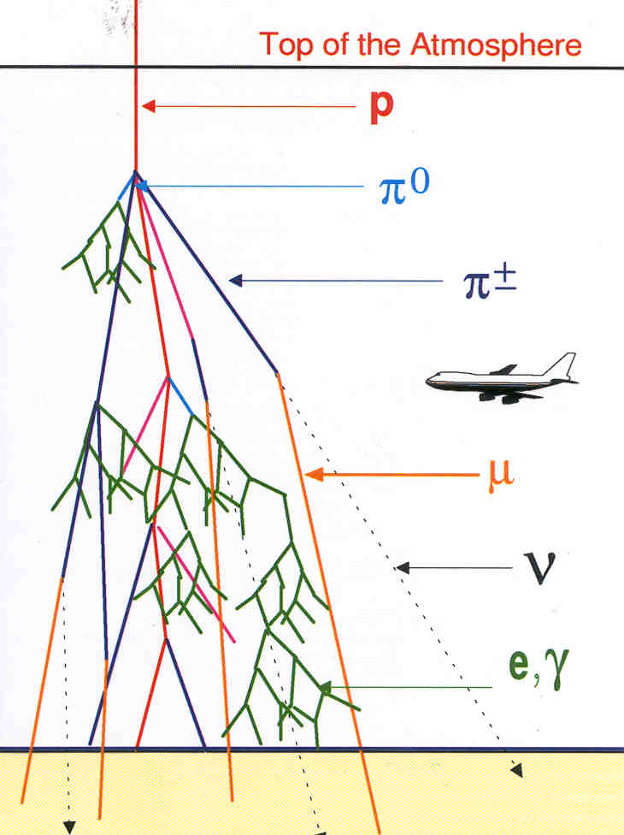
The Extensive Air Shower
Primary cosmic rays interact high in the Earth’s atmosphere
EASs result in billions of secondary particles
Fluorescence photons produced at core
May be observed with telescopes in the UV
Many particles reach the ground
May be observed with ground arrays

Slide 9
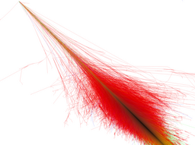
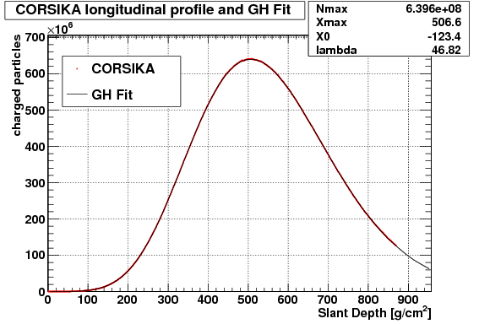
Air Shower Simulations (CORSIKA)
Simulated air shower –
E = 10¹⁵ eV proton, θ = 45°
Gaisser-Hillas parameterization
red – e^{+/-}, γ
green – μ^{+/-}
blue – hadrons (π^{0/+/-}, K^{0/+/-}, p, n)

Slide 10
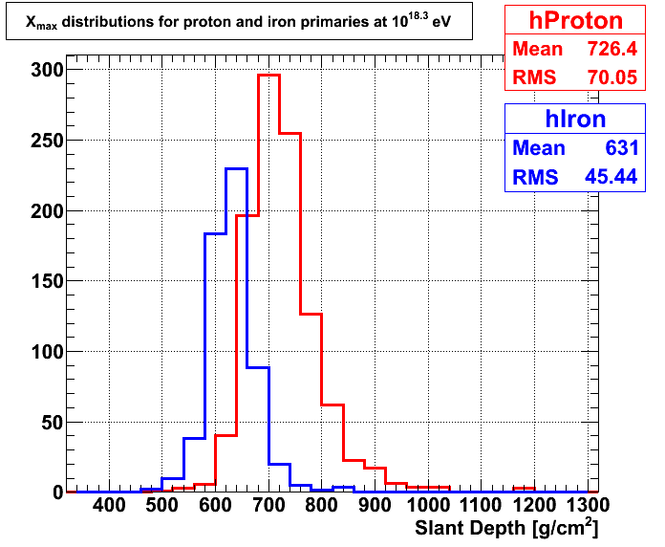
Proton and Iron X_{max} Distributions
Proton X_{max} distributions are deeper and wider than iron distributions
Resulting iron X_{max} is narrower than that from proton primaries
The distributions overlap
Good resolution in X_{max} is critical to successfully resolve composition

Slide 11
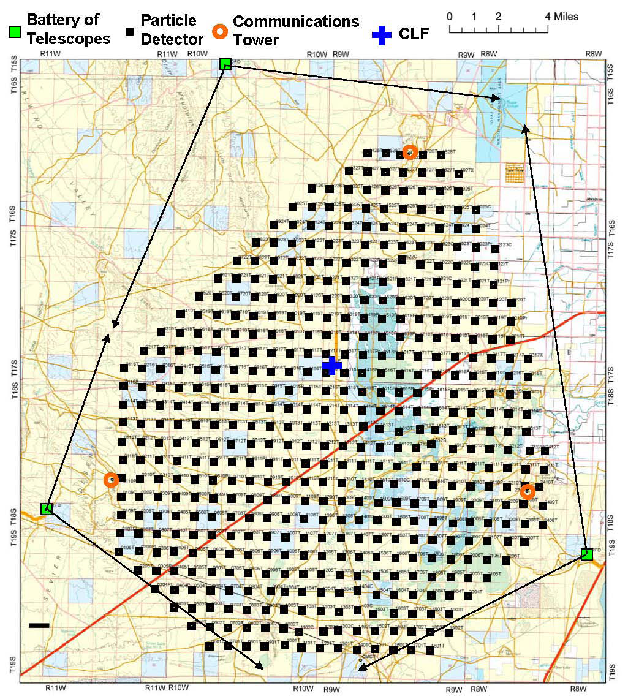
The Telescope Array Experiment

Slide 12
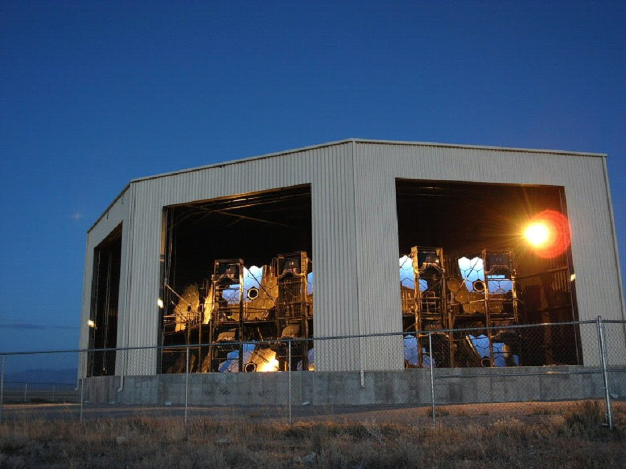
The Telescope Array Experiment
Black Rock Mesa and Long Ridge Fluorescence Detectors

Slide 13
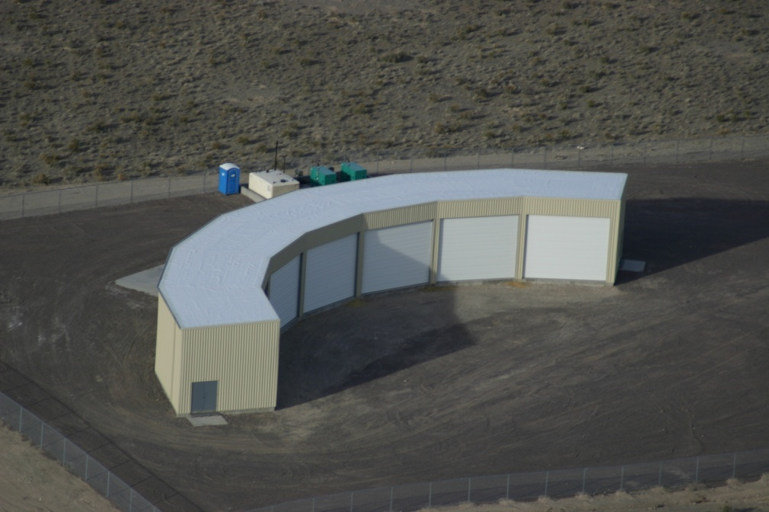
The Telescope Array Experiment
Middle Drum Fluorescence Detector

Slide 14
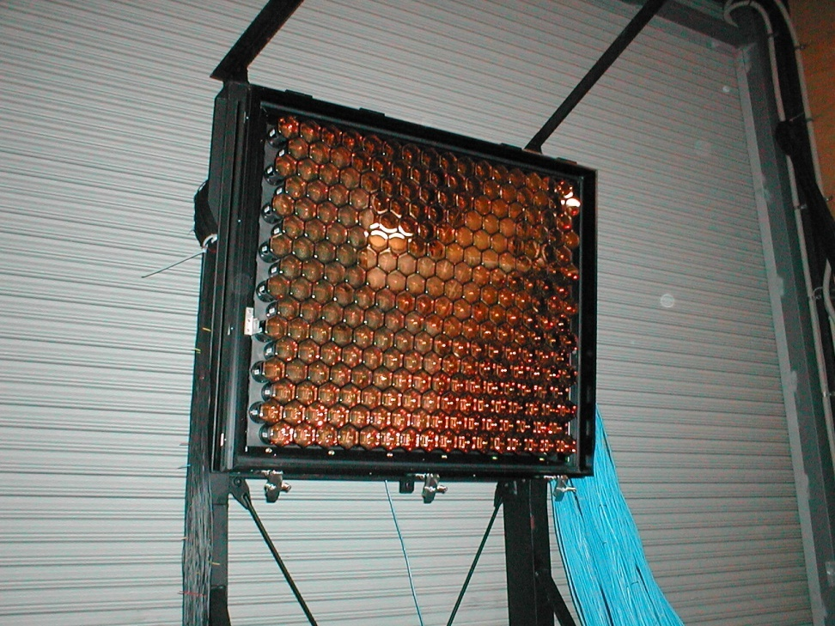
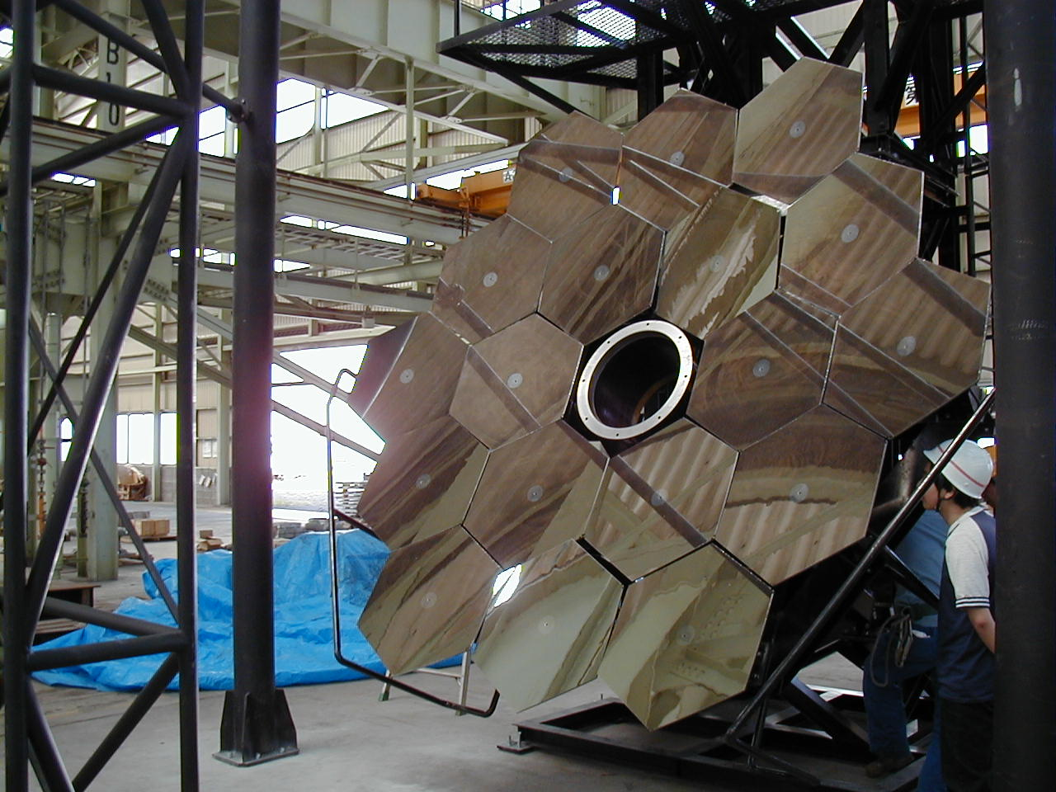
BRM/LR Fluorescence Detectors (I)
Image produced by 16x16 PMT “Cluster Box”
3.3 m diameter mirrors collect light and focus it on the cluster box

Slide 15
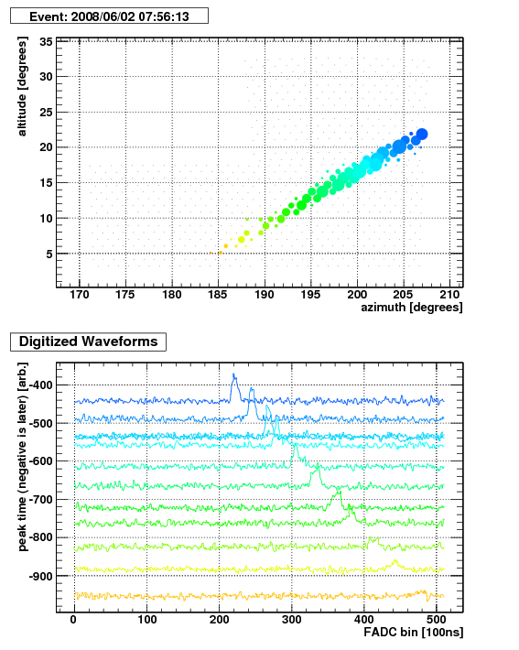
BRM/LR Fluorescence Detectors (II)
PMT provide 2D image with ~1° angular resolution
FADC digitization provides a PMT “trace” with 100 ns binning

Slide 16
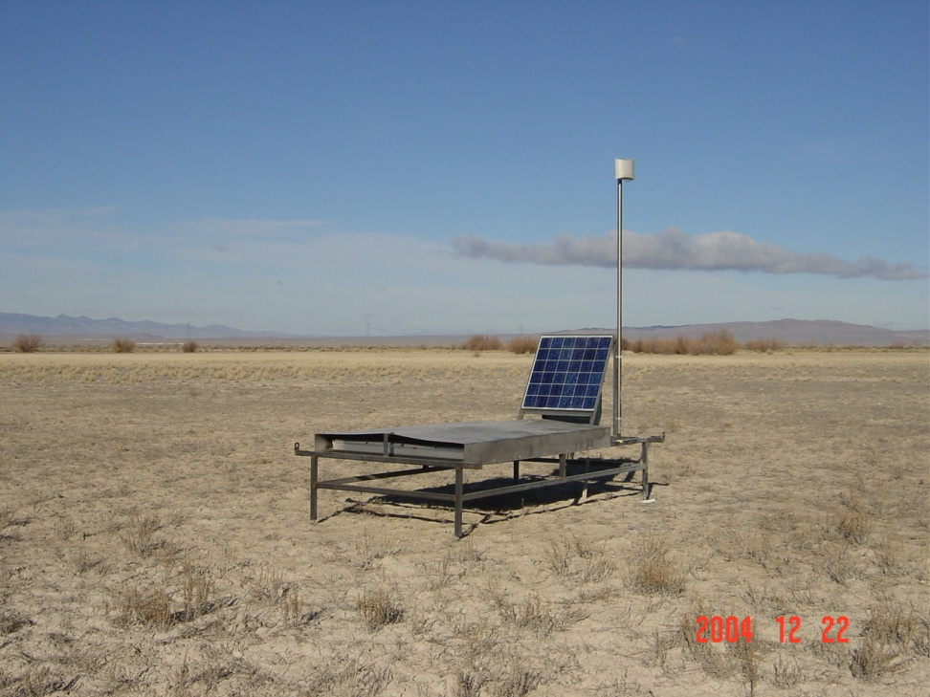
Surface Array
2 x 3 m² scintillator plastic
2 photo-multiplier tubes
1 per scintillator layer
Self powered with solar panels
Radio communication facilitates data acquisition and trigger

Slide 17
The Telescope Array Hybrid Detector
FD observes longitudinal development close to shower core
SD observes lateral distributions of particles
Hybrid data allows for the observation of X_{max} with well constrained geometries.
EAS Axis
Particle Tracks
Fluorescence Photons
Shower Front
FD Station
SD Array

Slide 18
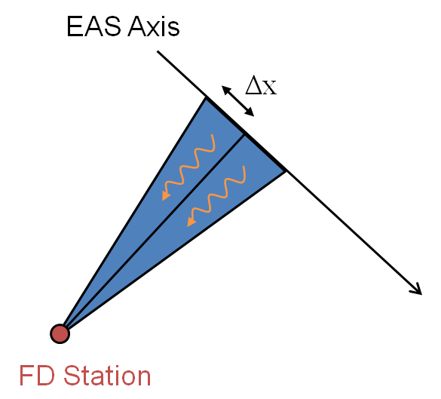
Detector Simulation
Fluorescence photons are simulated on shower axis based on GH parameters

Slide 19
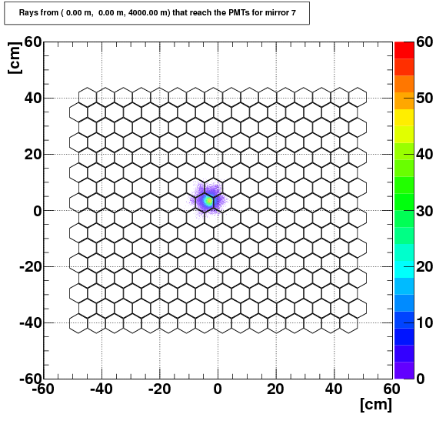
Detector Simulation
Fluorescence photons are simulated on shower axis based on GH parameters
Ray-tracing ensures correct treatment of optics

Slide 20
Detector Simulation
Fluorescence photons are simulated on shower axis based on GH parameters
Secondary particles from CORSIKA simulations are thrown against a simulated SD array
EAS Axis
Ray-tracing ensures correct treatment of optics
Particle Tracks
Shower Front

Slide 21
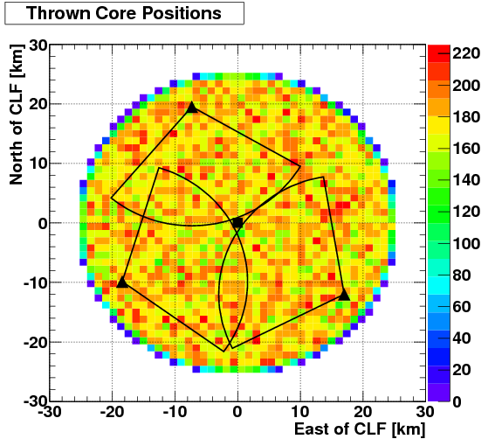
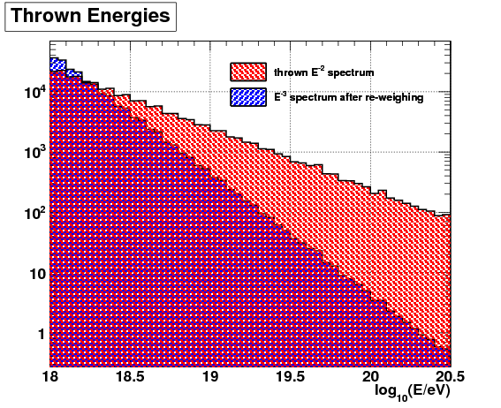
Thrown MC Distributions
Simulated MC distributions must reflect underlining physics
Must test the boundaries of the detector
Data and MC are identical
Both are reconstructed with the SAME programs
Distributions from MC must match those in the data!
Notes:
Distributions produced by the MC must match those found in the data
Will show good agreement

Slide 22
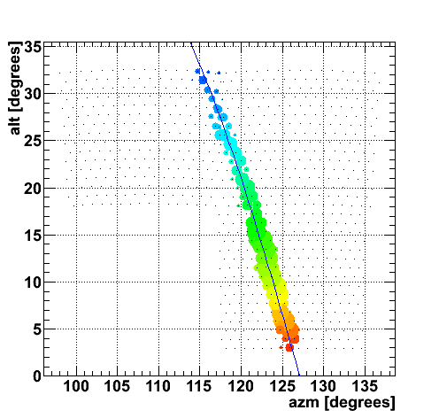
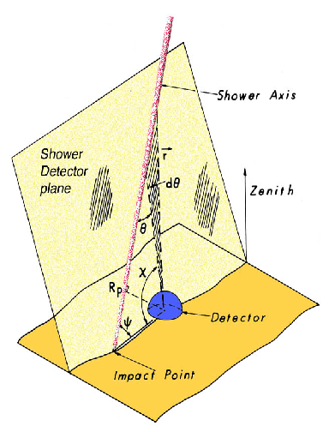
Hybrid Geometry Reconstruction (I)
Directions of triggered FD PMTs constrain event geometry to a Shower Detector Plane (SDP)
Cosmic ray event geometries:
R_{p} -- distance of closest approach
ψ -- Angle inside SPD
t₀ -- Time at R_{p}

Slide 23
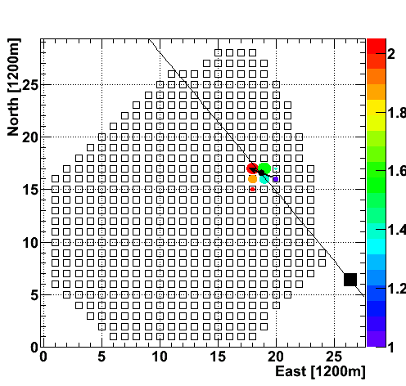
Hybrid Geometry Reconstruction (I)
Directions of triggered FD PMTs constrain event geometry to a Shower Detector Plane (SDP)
Cosmic ray event geometries:
R_{p} -- distance of closest approach
ψ -- Angle inside SPD
t₀ -- Time at R_{p}
Center of charge of triggered SDs constrains the core to a center of charge

Slide 24
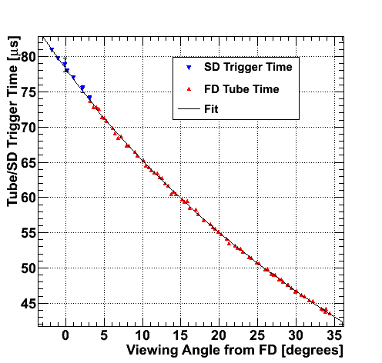
Hybrid Geometry Reconstruction (II)
Each triggered FD PMT and SD detector provides timing data
Construct a 4 component χ² function using all available information
Minimize in 5 parameters

Slide 25
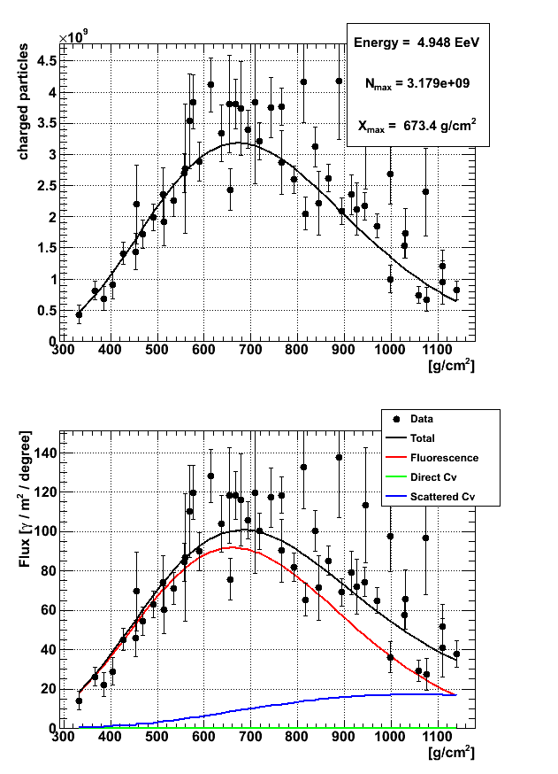
Longitudinal Profile Reconstruction
Using reconstructed geometry use Inverse Monte Carlo to find the best N_{max}, X_{max}.
GH fit leads to calculation of the shower energy

Slide 26
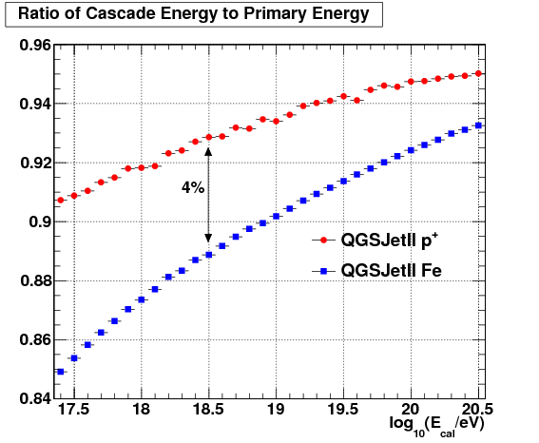
Missing Energy Correction
Some shower energy results in μ and ν particles and does not result in fluorescence
This “Missing Energy” must be corrected for in reconstruction
CORSIKA is used estimate the average missing energy
4% difference between proton and iron simulation

Slide 27
Data Set and Quality Cuts
All hybrid data before implementation of hybrid trigger
May 2008 – September 2010
Results in 454 hybrid events and 74 hybrid-stereo events
Cut | BR Events | LR Events
None | 3085 | 2720
Good Weather | 1933 | 1696
E > 10^{18.5} eV | 521 | 439
θ < 55° | 432 | 327
χ²_{geom} / DOF < 5 | 429 | 367
χ²_{prfl} / DOF < 5 | 350 | 327
X_{low} < X_{max} < X_{high} | 324 | 291
ψ < 130° && track time > 7μs | 294 | 269
core inside SD array | 276 | 252

Slide 28
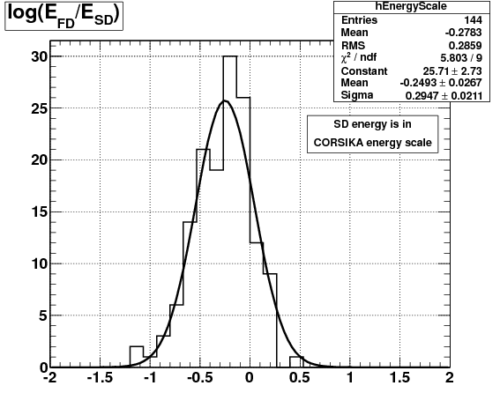
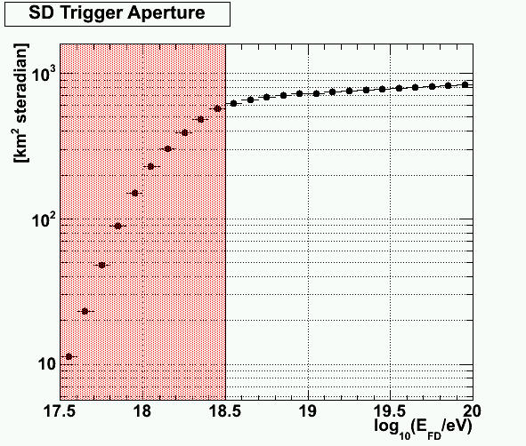
Energy Scale Treatment
Use hybrid events where the SD trigger aperture is flat
27% difference between FD and SD energies

Slide 29
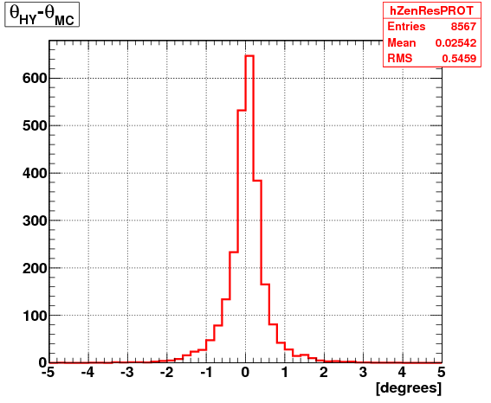
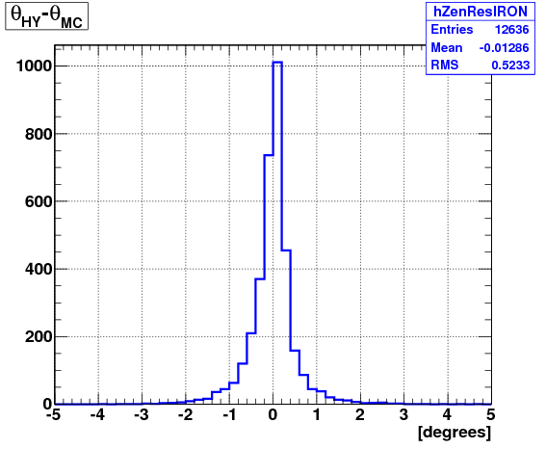
Resolution Studies (Zenith)
RMS: 0.54°
RMS: 0.52°

Slide 30
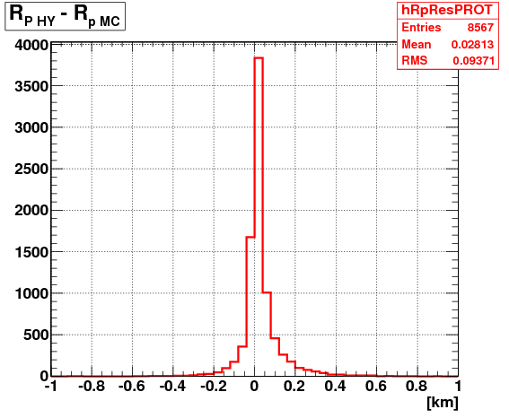
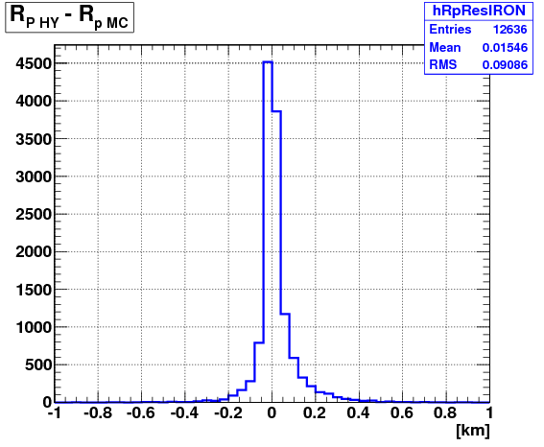
Resolution Studies (R_{p})
RMS: 94 m
RMS: 90 m

Slide 31
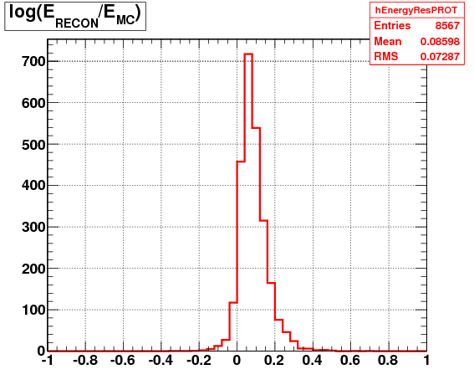
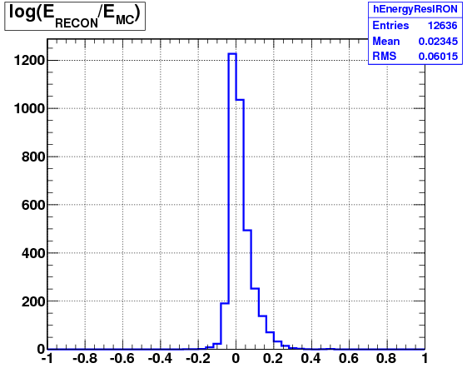
Resolution Studies (Energy)
Mean: 8.5%
RMS: 7.2%
Mean: 2.3%
RMS: 6.0%

Slide 32
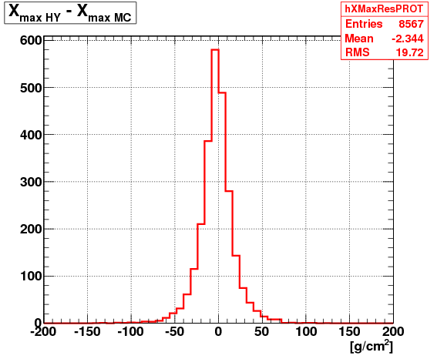
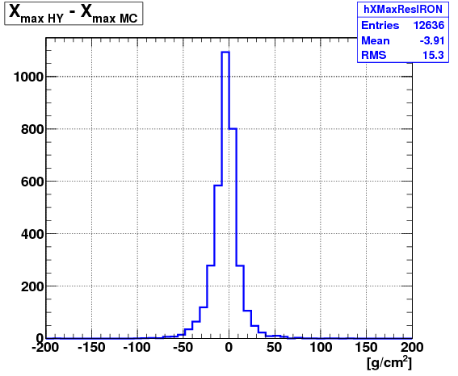
Resolution Studies (X_{max})
Mean: -2.3 g/cm²
RMS: 20 g/cm²
Mean: -3.9 g/cm²
RMS: 15 g/cm²

Slide 33
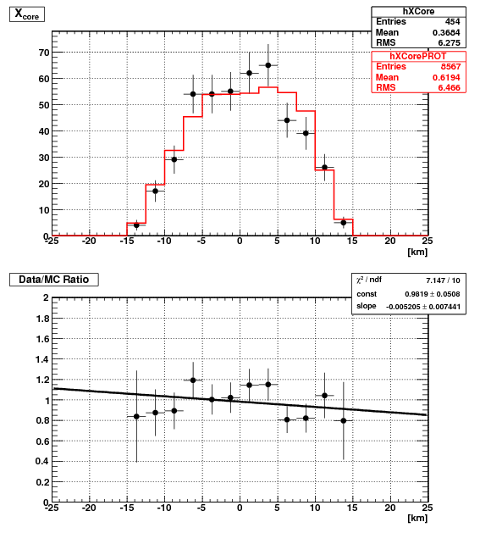
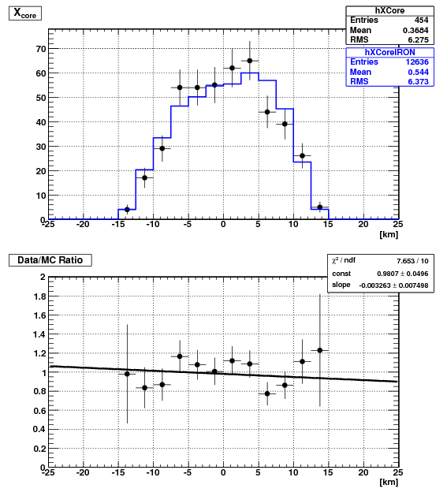
Data/Monte Carlo (X_{core})

Slide 34
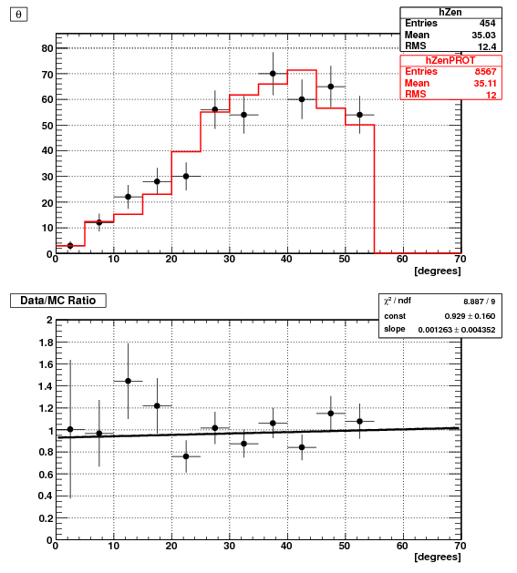
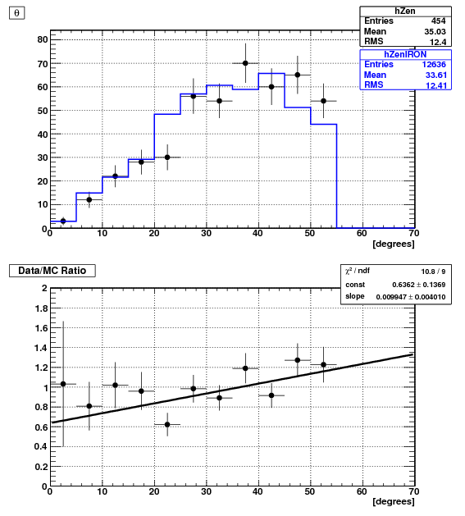
Data/Monte Carlo (Zenith Angle)

Slide 35
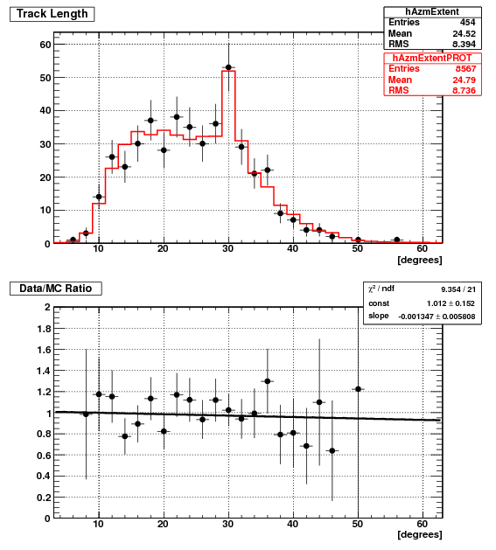
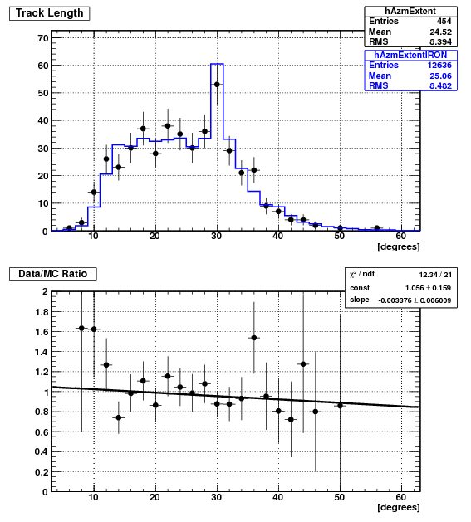
Data/Monte Carlo (Track Length)

Slide 36
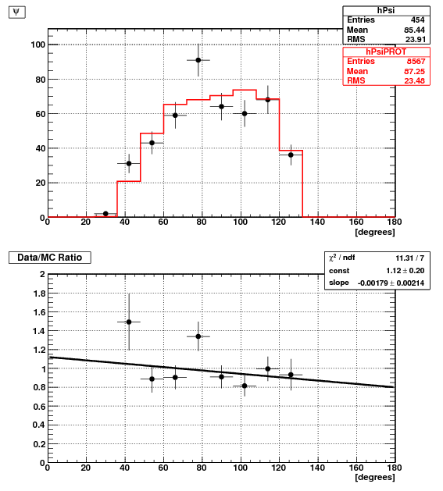
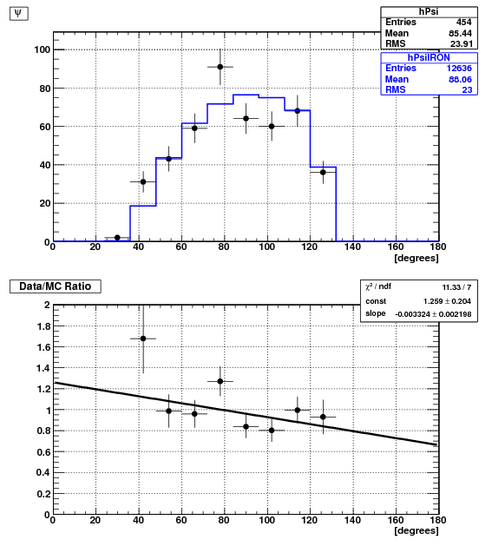
Data/Monte Carlo (ψ)
cut
cut

Slide 37
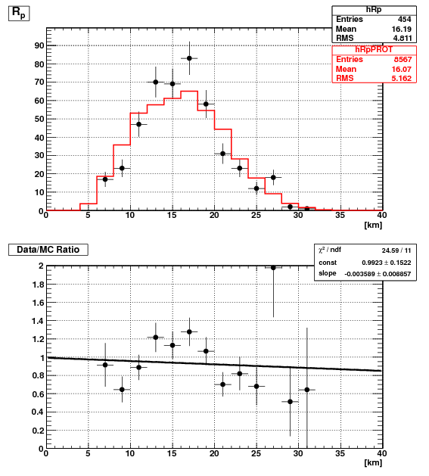
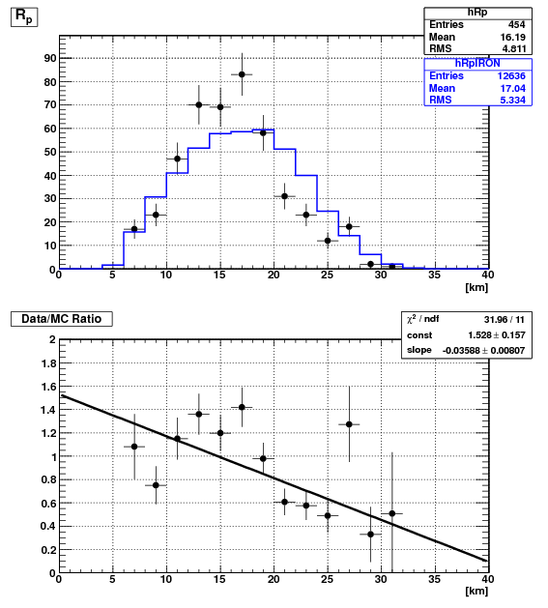
Data/Monte Carlo (R_{p})

Slide 38
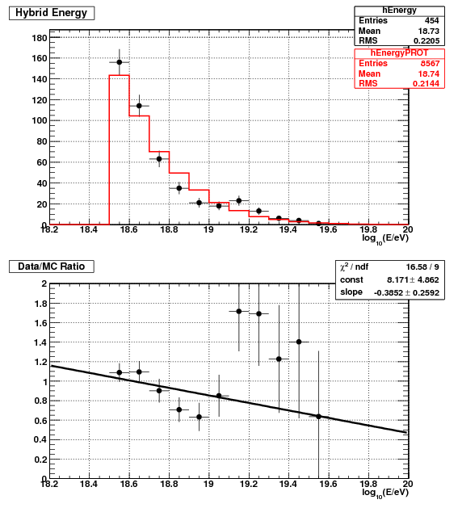

Data/Monte Carlo (Energy)
cut
cut

Slide 39


Data/Monte Carlo (X_{max})

Slide 40




X_{max} (10^{18.5} eV < E < 10^{18.9} eV)

Slide 41



X_{max} (10^{18.9} eV < E < 10^{19.3} eV)

Slide 42



X_{max} (E > 10^{19.3} eV)

Slide 43

Compatibility with MC
Using the binned X_{max} distributions (slides 55-57) we may use statistical tests to compare the distributions
Completely excludes iron MC until 10^{19.3} eV

Slide 44

MC Study: Mean X_{max}
The <X_{max}> can provide a single measurement to quantify the distributions in each energy bin
The fits shown here for proton and iron MC will be used to compare against the data

Slide 45

Mean X_{max}
The mean X_{max} from the data agrees with proton MC
The data is shifted 10 g/cm² shallower than the MC
Would find better agreement with different hadronic model
QGSJet01

Slide 46

Mean X_{max}
The mean X_{max} from the data agrees with proton MC
The data is shifted 10 g/cm² shallower than the MC
Would find better agreement with different hadronic model
QGSJet01
QGSJet01??

Slide 47




Shifted X_{max} (10^{18.5} eV < E < 10^{18.8} eV)

Slide 48



Shifted X_{max} (10^{18.8} eV < E < 10^{19.3} eV)

Slide 49



Shifted Xmax (E > 10^{19.3} eV)

Slide 50

Compatibility of shifted X_{max} with MC
Statistical tests of the shifted distributions provide compatibility of the shape
Iron MC is excluded below 10^{18.8} eV
Otherwise the statistical power is limited above 10^{18.8} eV

Slide 51
Conclusions
This study shows very clear compatibility with proton MC and exclude iron MC below 10^{19.3} eV
Data shows a 10 g/cm² shift in X_{max} from QGSJetII protons
Measurement of width and “shape” of X_{max} distributions corroborate the proton compatibility below 10^{18.8} eV
This result supports the GZK cutoff and pair-production theories to explain features of the cosmic ray spectrum

Slide 52
Support Slides

Slide 53

Electromagnetic Cascade (Heitler Model)
High energy photons pair produce producing e^{+/-}
e^{+/-} bremsstrahlung producing photons
Critical energy when electrons lost to ionization is dominate
84 MeV in the atmosphere
X_{max} may be observed with UV sensitive telescopes

Slide 54

Average Energy Deposited in CORSIKA
CORSIKA simulations are used to calculate the average energy deposited by air shower
Proton and iron simulations agree above s = 0.4
“age” is related to X as

Slide 55


Fluorescence Yield
N₂ fluorescence lines as measured by the FLASH experiment
Kakimoto fluorescence yield provides the number of photons per energy deposited

Slide 56

Model Dependence of X_{max}
Difference models of hadronic physics produce slightly different X_{max}
Model parameters must be extrapolated from accelerator results

Slide 57
Extra Resolutions

Slide 58


Resolution Studies (Cascade Energy)
Mean 8.7%
RMS: 7.3%
Mean: 6.5%
RMS: 6.1%

Slide 59


Resolution Studies (X_{max} in Energy)

Slide 60
Extra Comparison Plots

Slide 61


Data/Monte Carlo (χ_{GEOM}/DOF)
cut
cut

Slide 62


Data/Monte Carlo (χ_{PRFL}/DOF)
cut
cut

Slide 63


Data/Monte Carlo (X_{low})

Slide 64


Data/Monte Carlo (X_{high})

Slide 65


Data/Monte Carlo (Azimuth)

Slide 66


Data/Monte Carlo (Y_{core})

Slide 67


MC Study: X_{max} Acceptance

Slide 68

X_{max} Data After Cuts
Clear elongation rate in the mean (red circles)
Statistics are too poor to draw any conclusions above 10^{19.3} eV
Marked with solid line
MC is used to aid in interpretation of physics

Slide 69

X_{max} RMS
RMS of the distributions of X_{max} may be used to quantify the width
This measurement is susceptible to under-sampling

